Slide 1





Module 01 – Basic Concepts
WWW.SELACLOUD.COM

Slide 2

Agenda
What is Python?
Growth of python
Python – Getting Started
Python is interpreted language
Python first program
Indentations
Error Messages

Slide 3
What is Python?
• Python is a widely used, interactive, general purpose interpreted language​
• Python is stable, cross platform programming language ​
• Python is a high level and object-oriented programming language
​
• Python is an Open Source software, distributed under a liberal license​
• Python is simple, intuitive, dynamic and is easy to read and understand​
• Designed by Guido Rossum in the late eighties ​
Guido van Rossum
Notes:
Python is dynamically-typed and garbage-collected. It supports multiple programming paradigms, including structured (particularly, procedural), object-oriented and functional programming.
It was built to be as readable as possible, and is significant indentation driven (Off-side rule).
The language's core philosophy is summarized in the document The Zen of Python (PEP 20), which includes aphorisms such as:
Beautiful is better than ugly.
Explicit is better than implicit.
Simple is better than complex.
Complex is better than complicated.
Readability counts.
For further reading:
Python (programming language) - Wikipedia

Slide 4
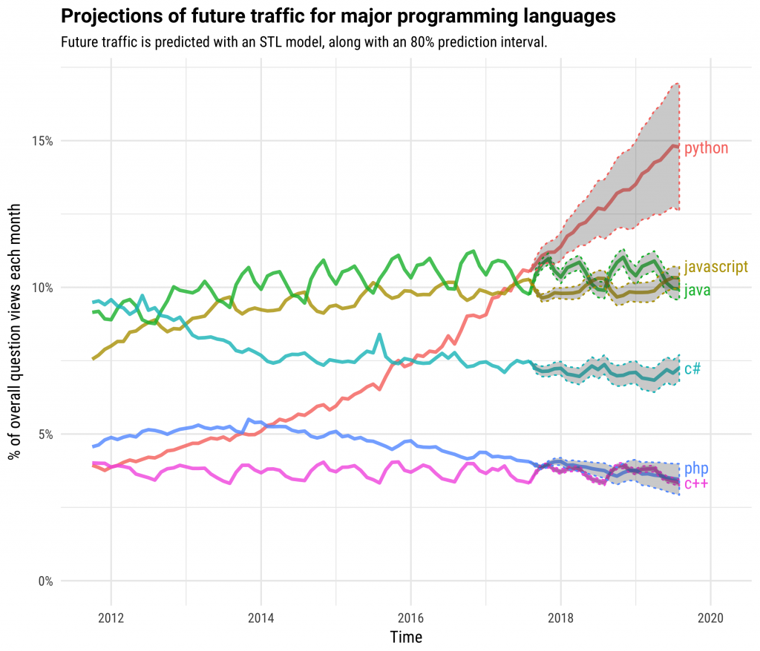
Growth of Python
Notes:
Python is dynamically-typed and garbage-collected. It supports multiple programming paradigms, including structured (particularly, procedural), object-oriented and functional programming.
It was built to be as readable as possible, and is significant indentation driven (Off-side rule).
The language's core philosophy is summarized in the document The Zen of Python (PEP 20), which includes aphorisms such as:
Beautiful is better than ugly.
Explicit is better than implicit.
Simple is better than complex.
Complex is better than complicated.
Readability counts.
For further reading:
Python (programming language) - Wikipedia

Slide 5
Getting Python
Where Do I Get Python? ​
The most up-to-date and current source code, binaries, documentations, news, etc. are available at the official website of Python:​
Python Official Website :
- http://www.python.org/​
Python documentation from the following site:​
– www.python.org/doc/​
Python download for Windows, Solaris, Linux:​
– http://www.python.org/download/​
If you are running a Linux (or most UNIX) system, you probably already have some python version installed on it. ​
Notes:
Python is dynamically-typed and garbage-collected. It supports multiple programming paradigms, including structured (particularly, procedural), object-oriented and functional programming.
It was built to be as readable as possible, and is significant indentation driven (Off-side rule).
The language's core philosophy is summarized in the document The Zen of Python (PEP 20), which includes aphorisms such as:
Beautiful is better than ugly.
Explicit is better than implicit.
Simple is better than complex.
Complex is better than complicated.
Readability counts.
For further reading:
Python (programming language) - Wikipedia

Slide 6
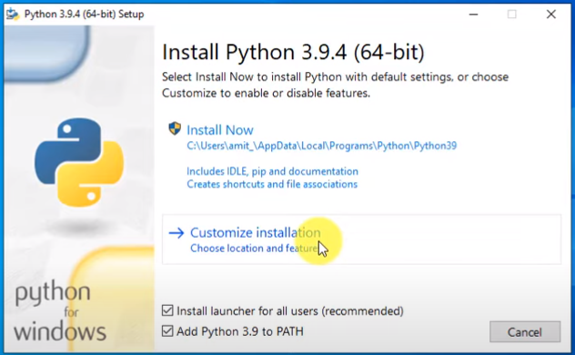
Python – Getting Started
Go to the download page on their website and click Python Version 3.9.9
2. Go to the bottom of the page and download the Windows or macOS installer
3. When launching the installer Check both boxes at the bottom
and click Customize Installation:

Slide 7
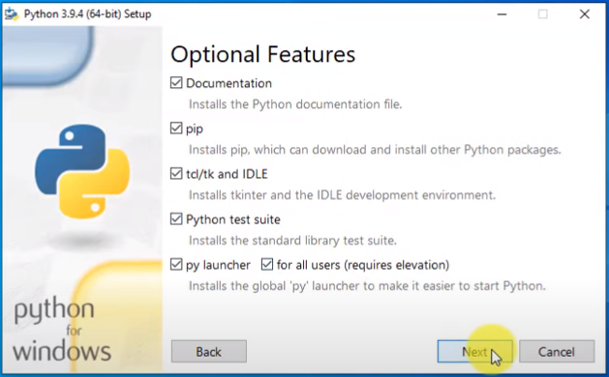
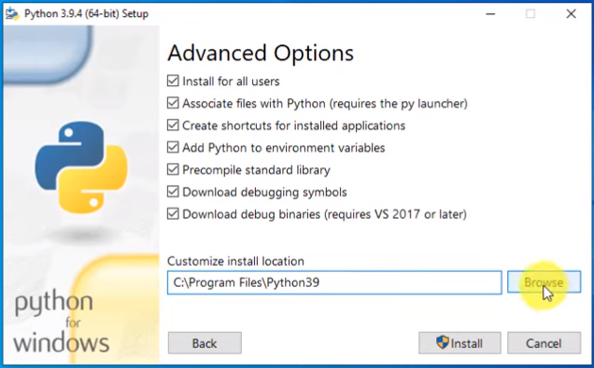
Python – Getting Started (cont.)
5. Check all the boxes at this page and click next:
6. Check all the boxes at this page also, and change the install location to the Program Files Folder and click Install:

Slide 8
Python VSCode Environment
VSCode is a popular code editor with extensive Python support, offering features like code completion, debugging, and an integrated terminal.
With its vast extension ecosystem, VSCode allows developers to customize and enhance their Python development experience to suit their specific needs.
VSCode's cross-platform compatibility and lightweight design make it a flexible choice for Python developers seeking a versatile and efficient coding environment.
Notes:
PyCharm is currently one of the most used IDE for python development, It provides code analysis, a graphical debugger, an integrated unit tester, integration with version control systems (VCSes), and supports web development with Django as well as data science with Anaconda.
It was created by JetBrains
It is mostly popular because of many things, such as:
It is considered as an intelligent code editor, fast and safe refactoring, and smart code.
Features for debugging, profiling, remote development, testing the code, auto code completion, quick fixing, error detection and tools of the database.
Support for Popular web technologies, web frameworks, scientific libraries and version control.

Slide 9
Download Visual Studio Code
https://code.visualstudio.com/download
Notes:
PyCharm is currently one of the most used IDE for python development, It provides code analysis, a graphical debugger, an integrated unit tester, integration with version control systems (VCSes), and supports web development with Django as well as data science with Anaconda.
It was created by JetBrains
It is mostly popular because of many things, such as:
It is considered as an intelligent code editor, fast and safe refactoring, and smart code.
Features for debugging, profiling, remote development, testing the code, auto code completion, quick fixing, error detection and tools of the database.
Support for Popular web technologies, web frameworks, scientific libraries and version control.

Slide 10
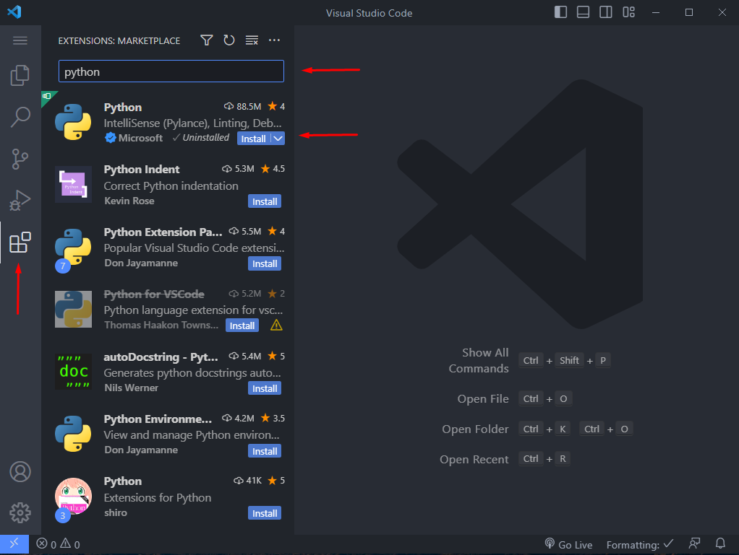
Setup VSCode for Python
Click on extension icon in navigation panel.
Write in search field “python” to find official Python extension.
Click “Install”
2
3
1
Notes:
PyCharm is currently one of the most used IDE for python development, It provides code analysis, a graphical debugger, an integrated unit tester, integration with version control systems (VCSes), and supports web development with Django as well as data science with Anaconda.
It was created by JetBrains
It is mostly popular because of many things, such as:
It is considered as an intelligent code editor, fast and safe refactoring, and smart code.
Features for debugging, profiling, remote development, testing the code, auto code completion, quick fixing, error detection and tools of the database.
Support for Popular web technologies, web frameworks, scientific libraries and version control.

Slide 11
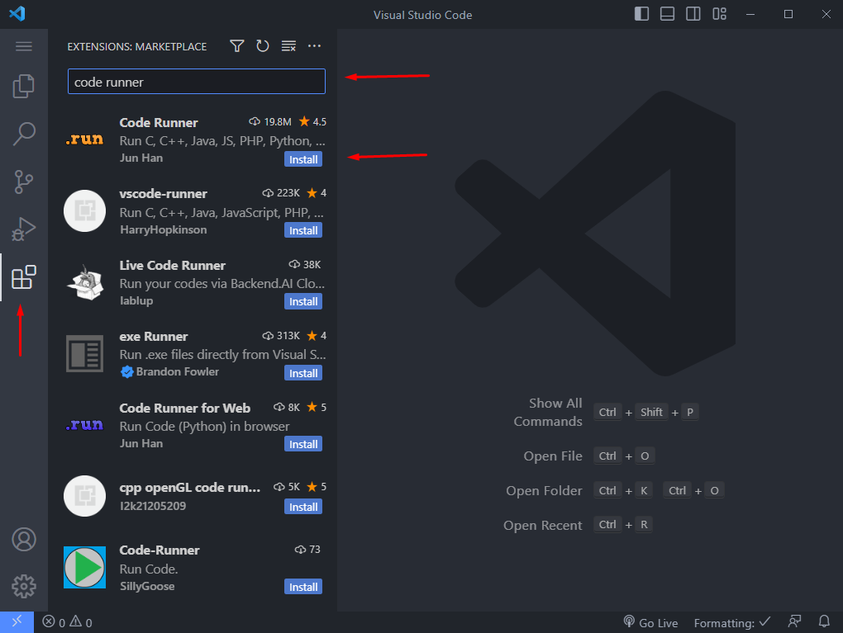
Setup RunTime extension
Click on extension icon in navigation panel.
Write in search field “code runner”.
Click “Install”
2
3
1
Notes:
PyCharm is currently one of the most used IDE for python development, It provides code analysis, a graphical debugger, an integrated unit tester, integration with version control systems (VCSes), and supports web development with Django as well as data science with Anaconda.
It was created by JetBrains
It is mostly popular because of many things, such as:
It is considered as an intelligent code editor, fast and safe refactoring, and smart code.
Features for debugging, profiling, remote development, testing the code, auto code completion, quick fixing, error detection and tools of the database.
Support for Popular web technologies, web frameworks, scientific libraries and version control.

Slide 12
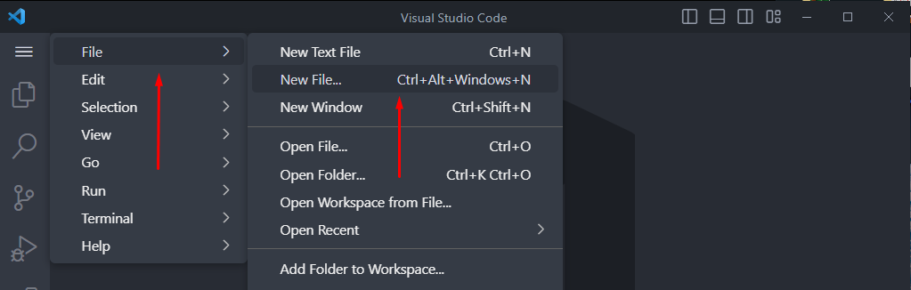
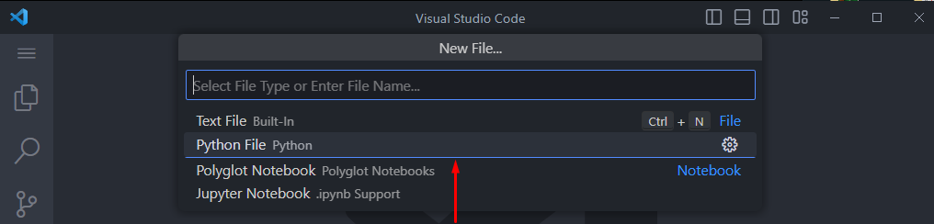
Creating new python file
Click on “File” section
Then click “New File…” (Or just Ctrl + Alt + Win + N)
Click on “Python File” to create new one.
1
2
3
Notes:
PyCharm is currently one of the most used IDE for python development, It provides code analysis, a graphical debugger, an integrated unit tester, integration with version control systems (VCSes), and supports web development with Django as well as data science with Anaconda.
It was created by JetBrains
It is mostly popular because of many things, such as:
It is considered as an intelligent code editor, fast and safe refactoring, and smart code.
Features for debugging, profiling, remote development, testing the code, auto code completion, quick fixing, error detection and tools of the database.
Support for Popular web technologies, web frameworks, scientific libraries and version control.

Slide 13
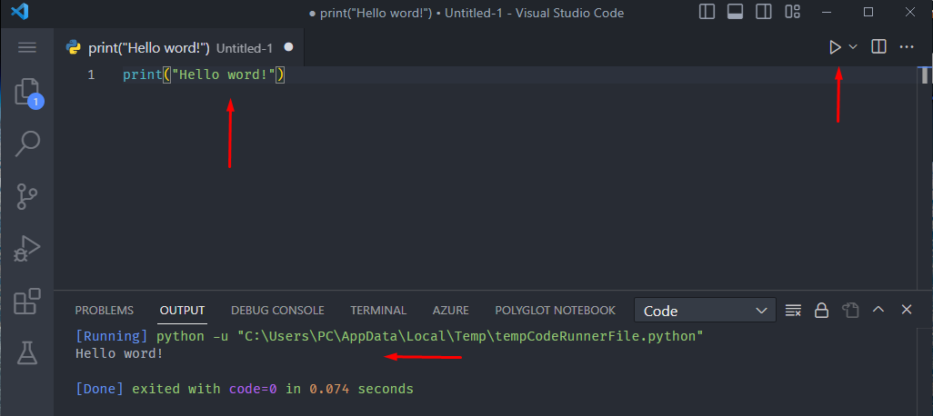
Running python
Write some code
Click on “Run” button
Sea output in below section
2
1
3
Notes:
PyCharm is currently one of the most used IDE for python development, It provides code analysis, a graphical debugger, an integrated unit tester, integration with version control systems (VCSes), and supports web development with Django as well as data science with Anaconda.
It was created by JetBrains
It is mostly popular because of many things, such as:
It is considered as an intelligent code editor, fast and safe refactoring, and smart code.
Features for debugging, profiling, remote development, testing the code, auto code completion, quick fixing, error detection and tools of the database.
Support for Popular web technologies, web frameworks, scientific libraries and version control.

Slide 14
Python PyCharm Environment - alternative
PyCharm is an IDE for software development in Python
It is used and loved by many because all it’s features
It has easy to use and read debugger
Notes:
PyCharm is currently one of the most used IDE for python development, It provides code analysis, a graphical debugger, an integrated unit tester, integration with version control systems (VCSes), and supports web development with Django as well as data science with Anaconda.
It was created by JetBrains
It is mostly popular because of many things, such as:
It is considered as an intelligent code editor, fast and safe refactoring, and smart code.
Features for debugging, profiling, remote development, testing the code, auto code completion, quick fixing, error detection and tools of the database.
Support for Popular web technologies, web frameworks, scientific libraries and version control.

Slide 15
PyCharm Community Edition
https://www.jetbrains.com/pycharm/download/#section=windows

Slide 16
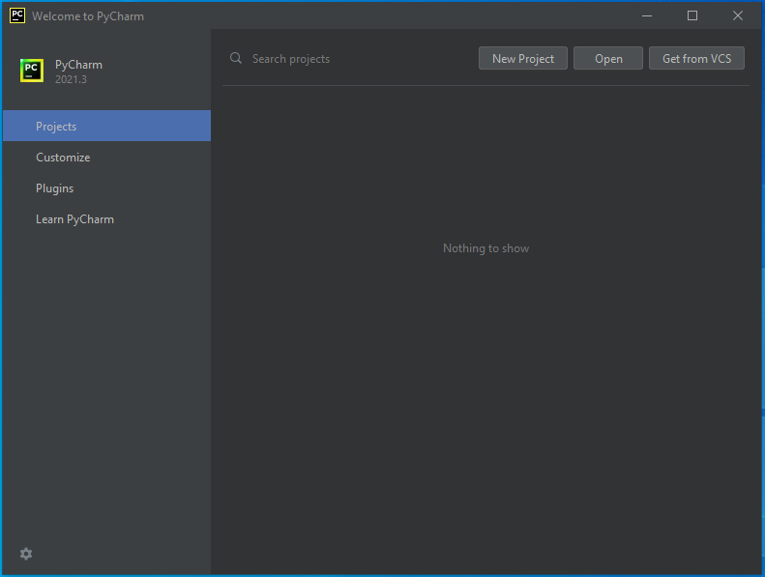
Opening New Project
When first opening PyCharm you will see this screen, press the new project button:

Slide 17
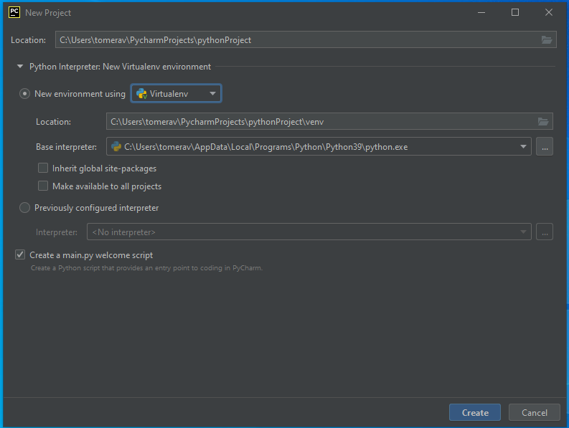
Opening New Project (contd.)
Project Location
Project Environment
Base interpreter
Notes:
This is the main screen for opening a new project, all project are "of the same type" but not really.
We can choose our projects name by changing the last section of the location box
We can choose different environments like Virtualenv(the base one here), or Conda.
Also, we can use a new (base) interpreter or just pick one of our previously used ones if we choose so. For beginners this is all we need to know, we want a new interpreter

Slide 18
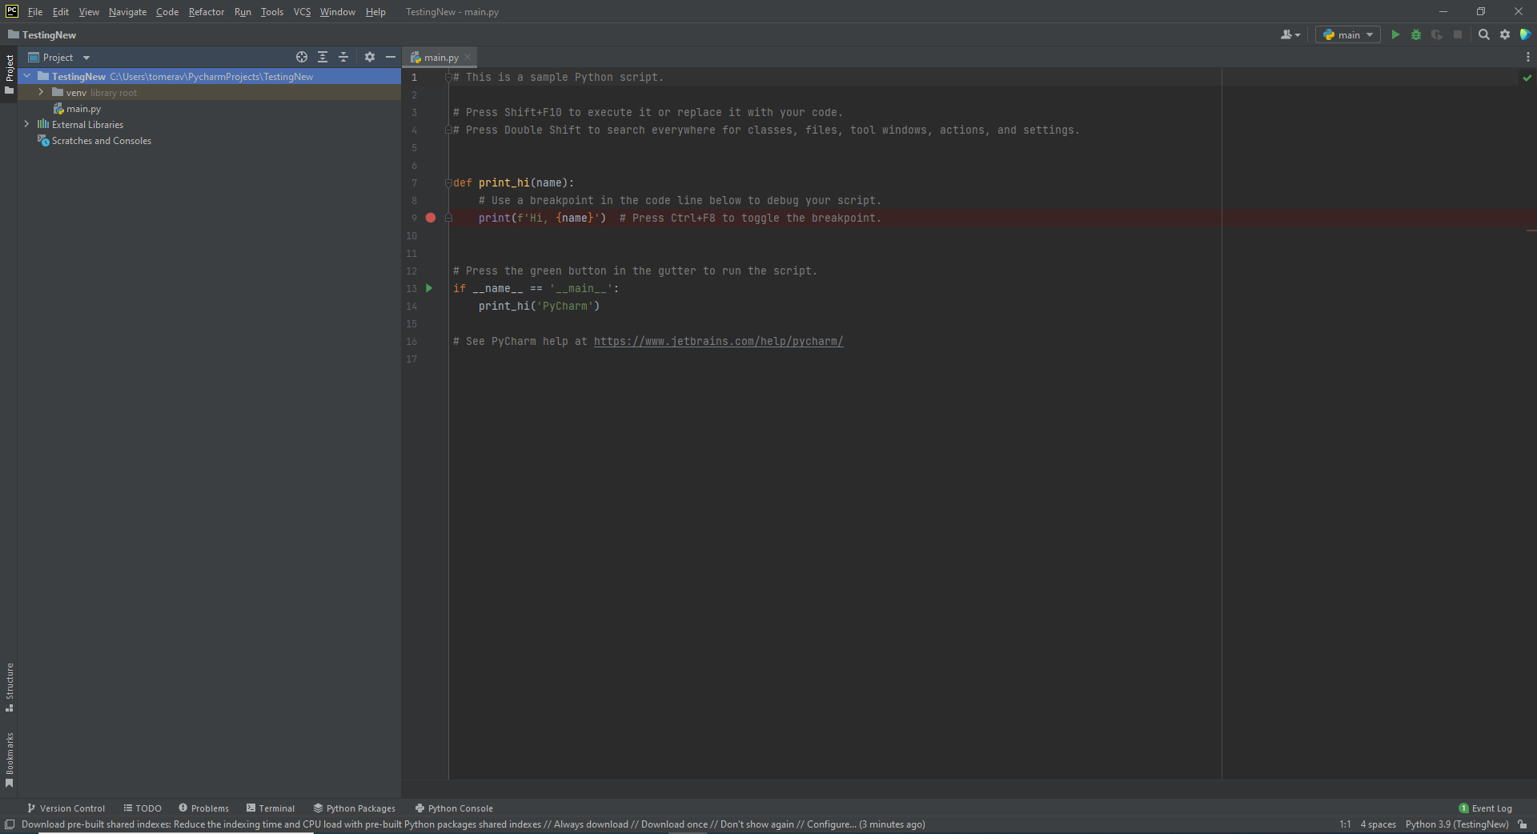
IDE – Integrated Development Environment
Run
Script
Open Scripts
Menu Bar
Project Explorer
Coding Section
Tools
Notes:
This is the main work area in PyCharm: The Coding section is where you write you code
Menu bar is all the options, setting etc.
Project explorer is where all of our current project files and folders are located, we can navigate between them there
The tools are our main uses, like the console, terminal, debug section, etc.
The run script section is where we run our current open script, of course our script can run our entire project, depends on what's connected to the script we are running

Slide 19
Python is interpreted language
Python is an interpreted language. It means that our code processed at a real time, by interpreter, without compiling it before the execution.
Interpreted code runs slower than a compiled one, because the interpreter must analyze each statement of the program each time it is executed.
This run-time analysis is known as "interpretive overhead".
Notes:
This is the main work area in PyCharm: The Coding section is where you write you code
Menu bar is all the options, setting etc.
Project explorer is where all of our current project files and folders are located, we can navigate between them there
The tools are our main uses, like the console, terminal, debug section, etc.
The run script section is where we run our current open script, of course our script can run our entire project, depends on what's connected to the script we are running

Slide 20
Python First program
One of the ways to run python code is to write a script file that contains python commands
Python scripts usually have an extension of .py
Lets start with a simple python script – first.py
- Open any text editor or IDE
- Save the first program as first.py
Type the following command in it:
- Run the script. If the commands are correct, python will execute the script
print("Hello world!")
Notes:
This is the main work area in PyCharm: The Coding section is where you write you code
Menu bar is all the options, setting etc.
Project explorer is where all of our current project files and folders are located, we can navigate between them there
The tools are our main uses, like the console, terminal, debug section, etc.
The run script section is where we run our current open script, of course our script can run our entire project, depends on what's connected to the script we are running

Slide 21
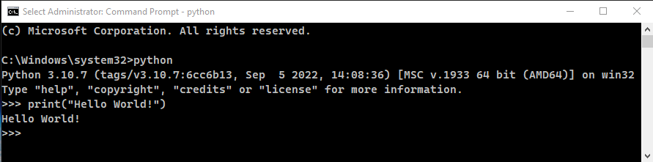
Python First program – cont’d
Another way to run python commands is to run python shell – the interactive mode
To do so, open shell or command processor (like cmd) and type python exe path and you will see the following output:
In interactive mode, python interpreter is waiting for users commands and executes them as given.
Whenever you exit the interactive mode, the commands are gone.
Notes:
This is the main work area in PyCharm: The Coding section is where you write you code
Menu bar is all the options, setting etc.
Project explorer is where all of our current project files and folders are located, we can navigate between them there
The tools are our main uses, like the console, terminal, debug section, etc.
The run script section is where we run our current open script, of course our script can run our entire project, depends on what's connected to the script we are running

Slide 22
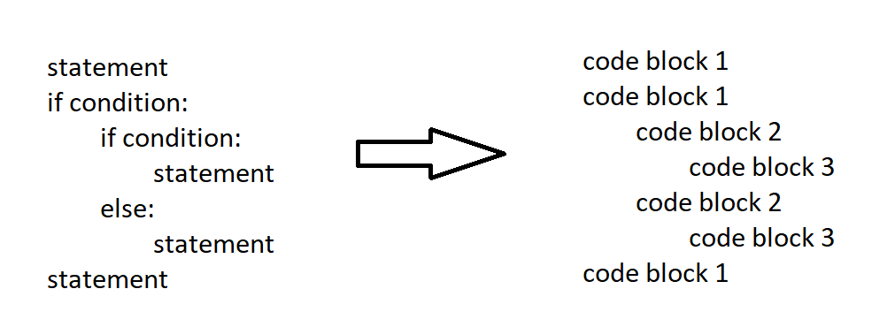
Python First program – cont’d
One of the most important things for flow controls, functions definitions, classes and other block-defined statements is the fact that there is no braces to indicate blocks of code.
Blocks of code are denoted by line indentation
Indentations are represented by any number of spaces/tabs, but all statements within the same block must be indented the same.
Notes:
This is the main work area in PyCharm: The Coding section is where you write you code
Menu bar is all the options, setting etc.
Project explorer is where all of our current project files and folders are located, we can navigate between them there
The tools are our main uses, like the console, terminal, debug section, etc.
The run script section is where we run our current open script, of course our script can run our entire project, depends on what's connected to the script we are running

Slide 23
Demo 01: Print your name

Slide 24

Demo 01: Print your name
print("Sela student!")

Slide 25
Console Methods

Slide 26
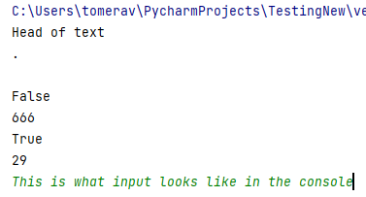
Demo Code: Console Methods
print("Head of text") print(".") print() print(False) print(666) print(True) print(29) input()
Notes:
The Python console has two main methods: print and input.
Print, like its name, prints whatever is between the brackets, sometimes things might not be printed like we think they will (like Classes instances), we will see them as we progress. Input, like its name, receives an input from the user in the console, and we can of course use them to do different things (inputs are always of type string! Remember that!)

Slide 27
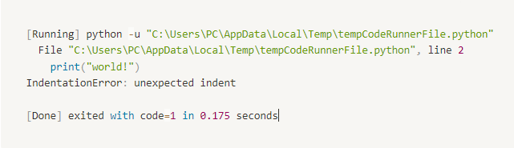
Error Messages
If you incorrectly type a statement or placed the statement in incorrect place, the interpreter will detect the error and tell you what it is and where it is located.
For example, look at following code (This program contains one small error):
Non-treated will terminate the process with non-zero exit status.
The interpreter prints an error message and its stack trace.
print("Hello") print("World")
Output:
Notes:
The Python console has two main methods: print and input.
Print, like its name, prints whatever is between the brackets, sometimes things might not be printed like we think they will (like Classes instances), we will see them as we progress. Input, like its name, receives an input from the user in the console, and we can of course use them to do different things (inputs are always of type string! Remember that!)

Slide 28
Summary
The Python programming language is an easy to read-write language
Python is now gaining more and more popularity (creating jobs demands)
VSCode is one of the most used IDE’s for Python
VSCode has built in debugger and console

Slide 29
Lab 01

